Slide 1
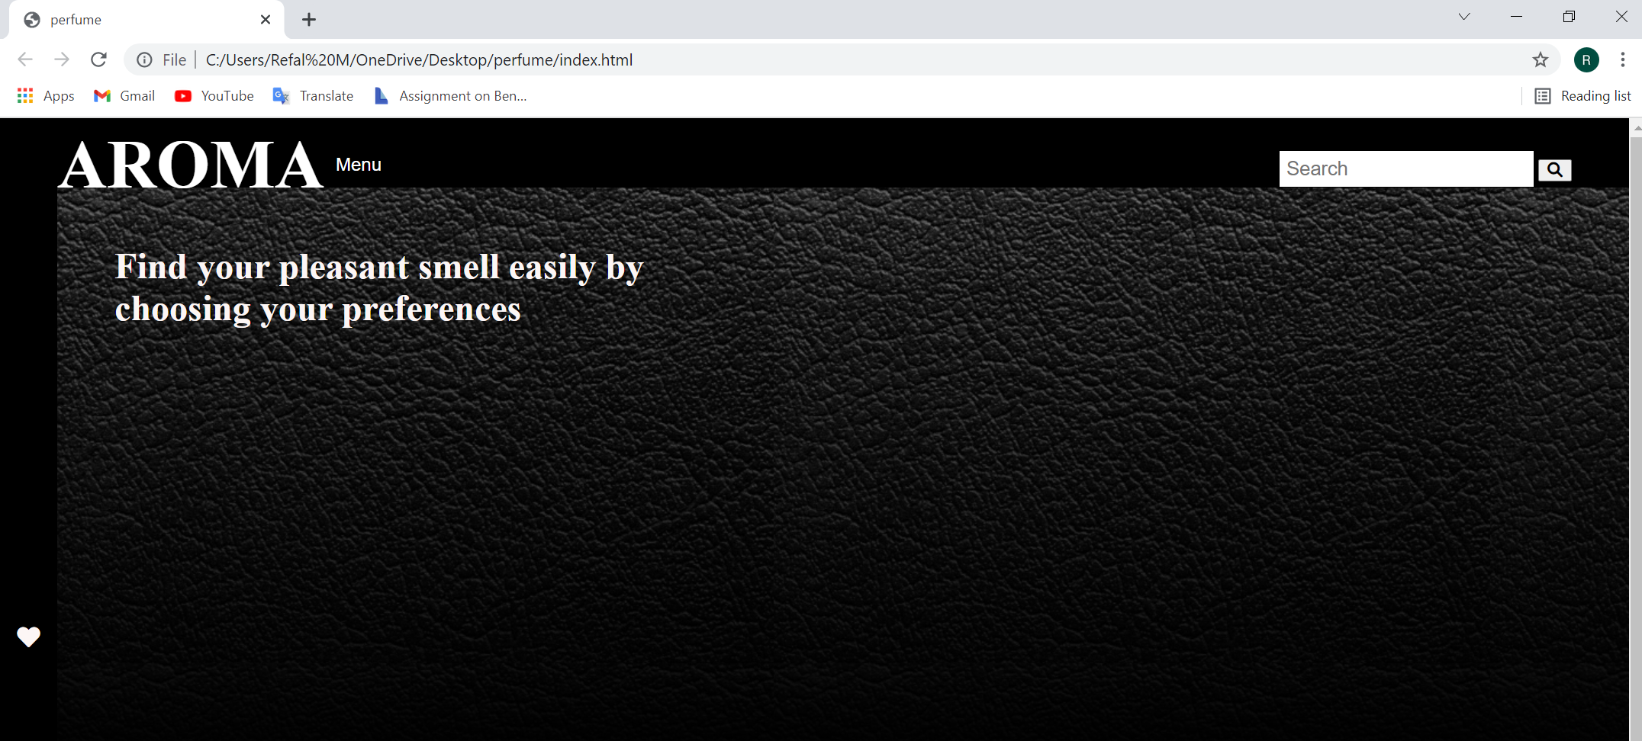
AROMA
/əˈroʊ·mə/ : a strong, usually pleasant smell.
This website is useful to those who are searching for perfumes with good prices.
Here is the website interface. There is AROMA which is the website name, search engine, favorites and dropdown menu.

Slide 2
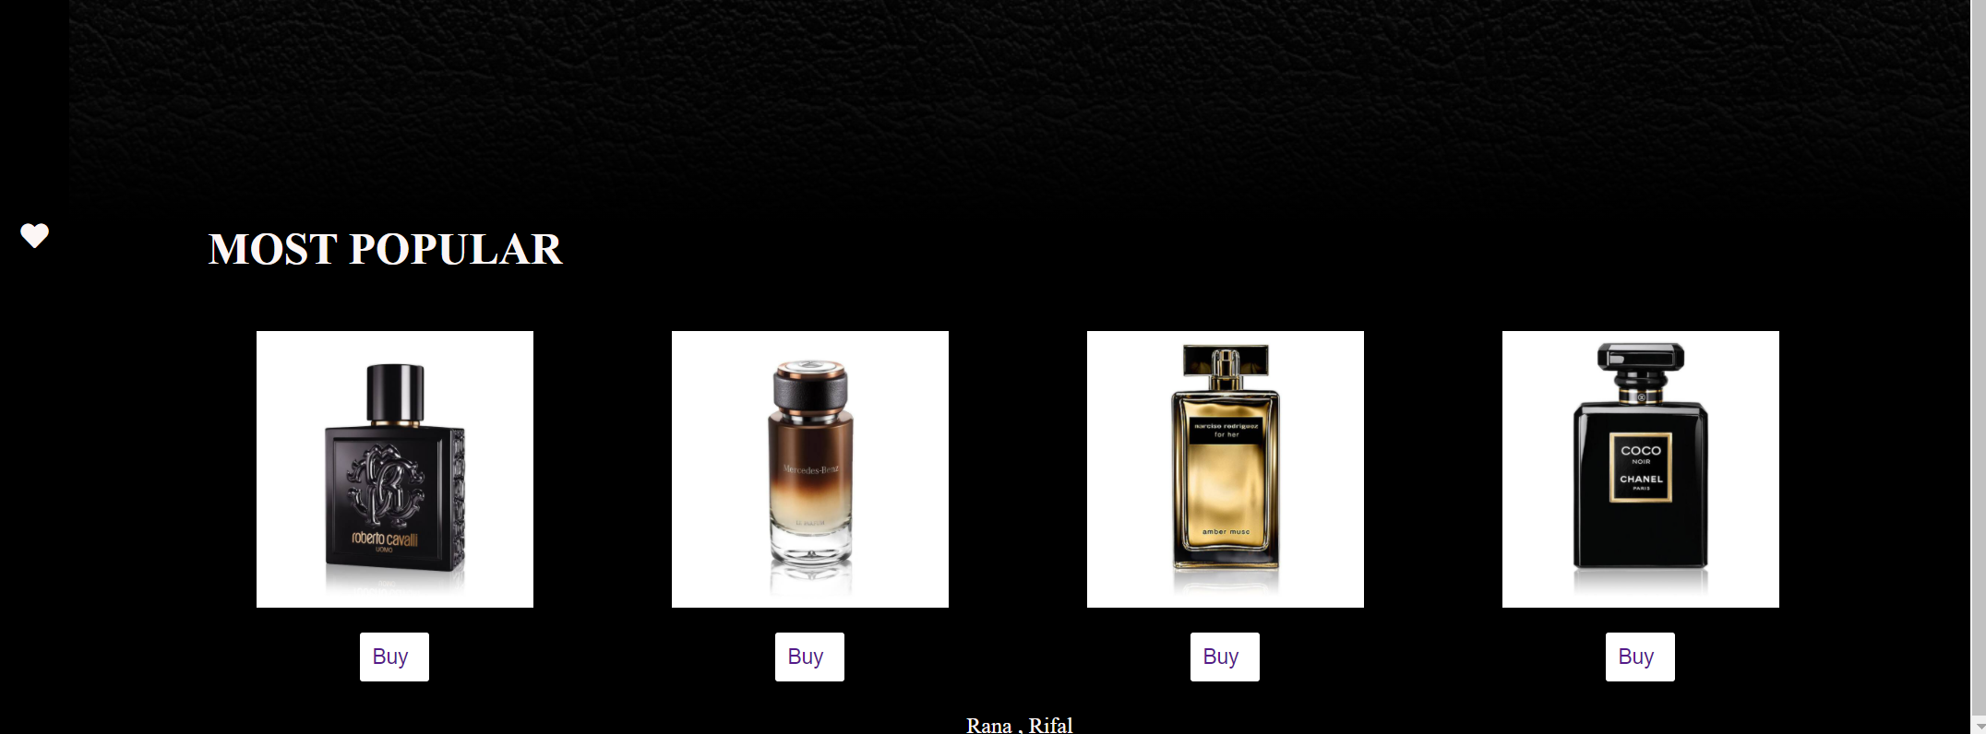
Down in the website interface the user can see a bar for suggested and most popular perfumes.

Slide 3
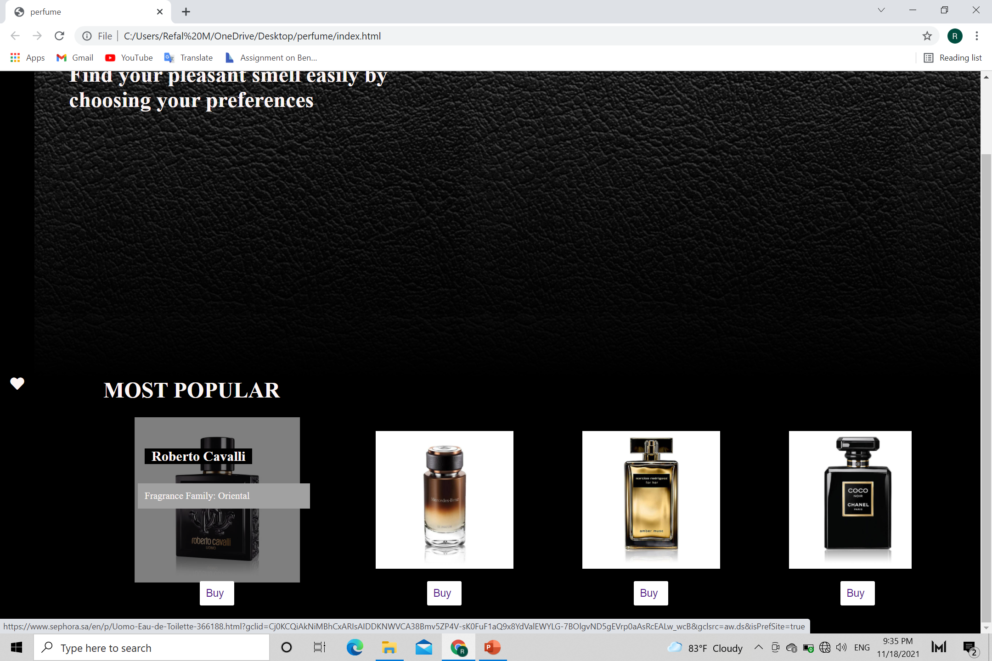
When the user hover on the desired perfume, the name and the fragrance family of it will pop-up.
When button “Buy” is clicked, the website will direct the user to another selling website.

Slide 4
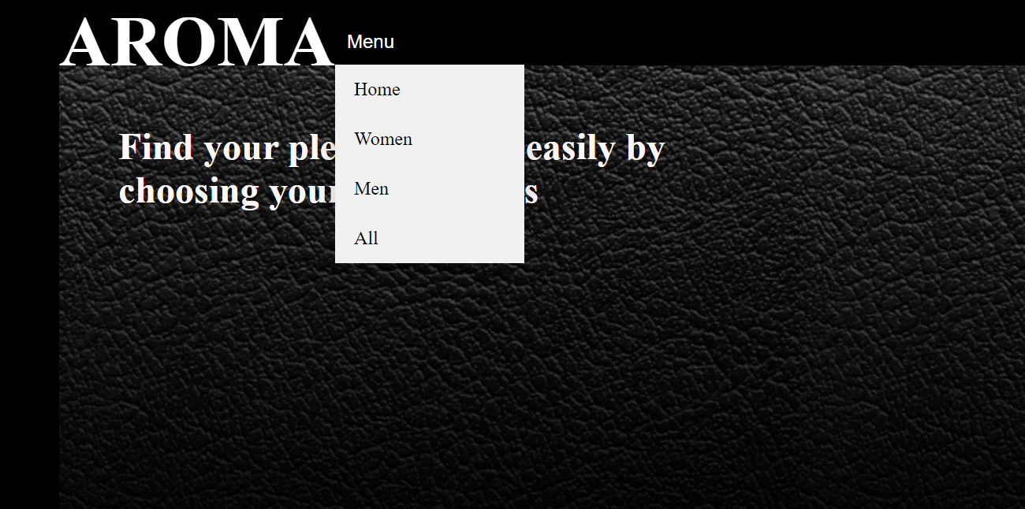
At the navigation bar there’s a dropdown menu to choose the desired gender of the perfume.

Slide 5
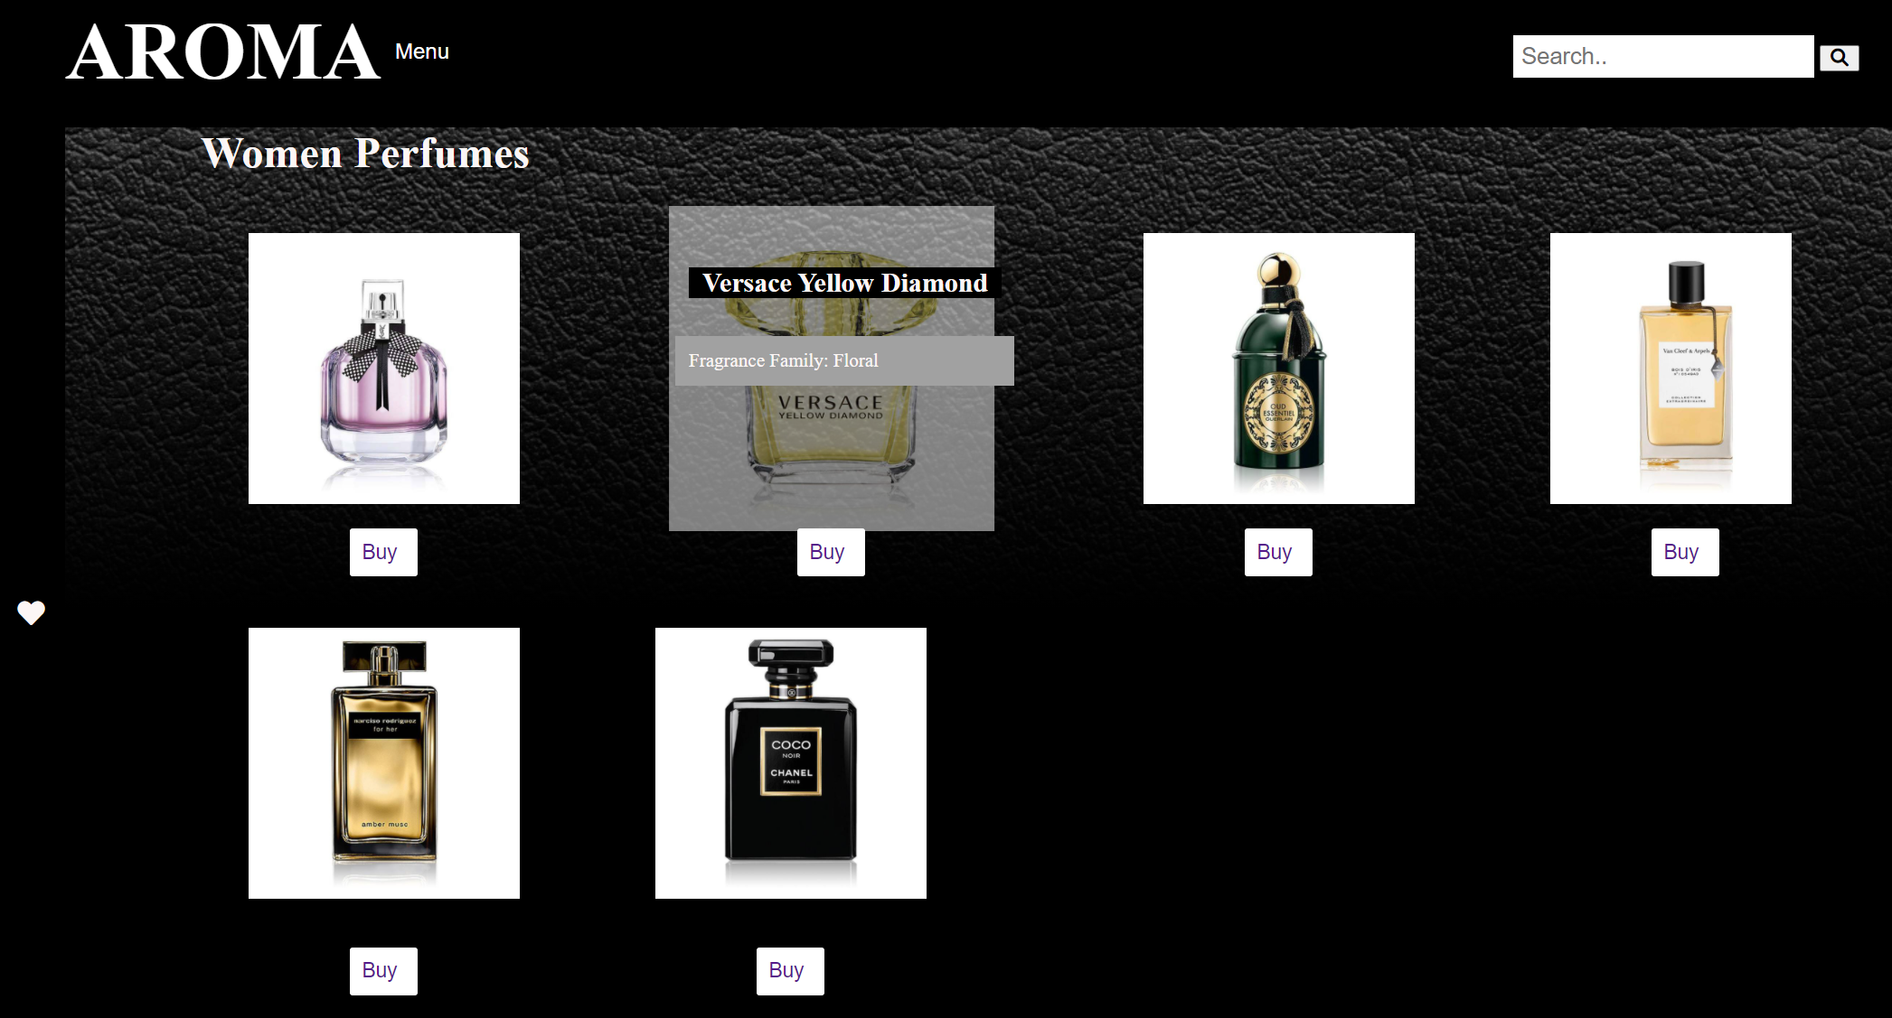
Here is the Women Perfumes page.

Slide 6
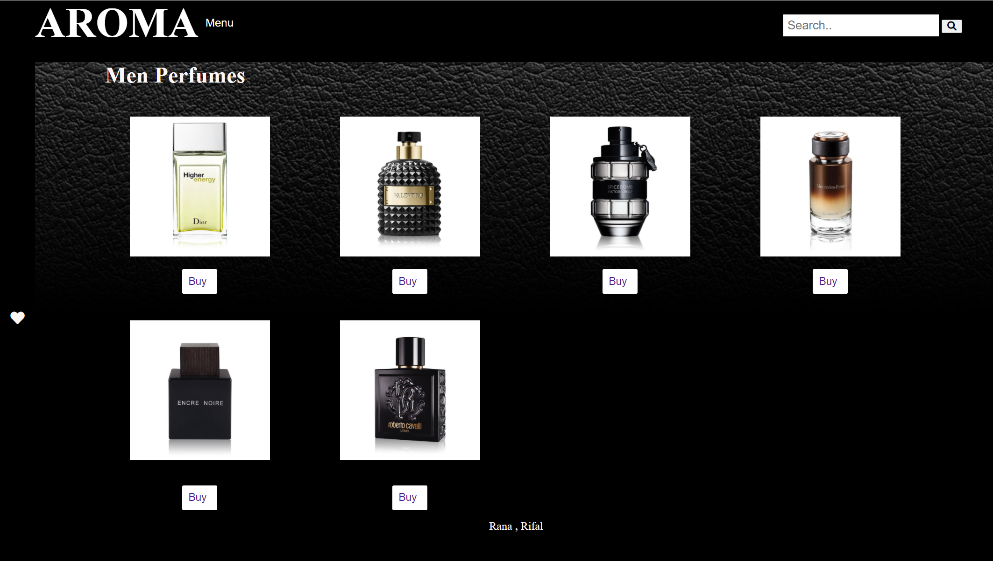
Men Perfumes page.

Slide 7
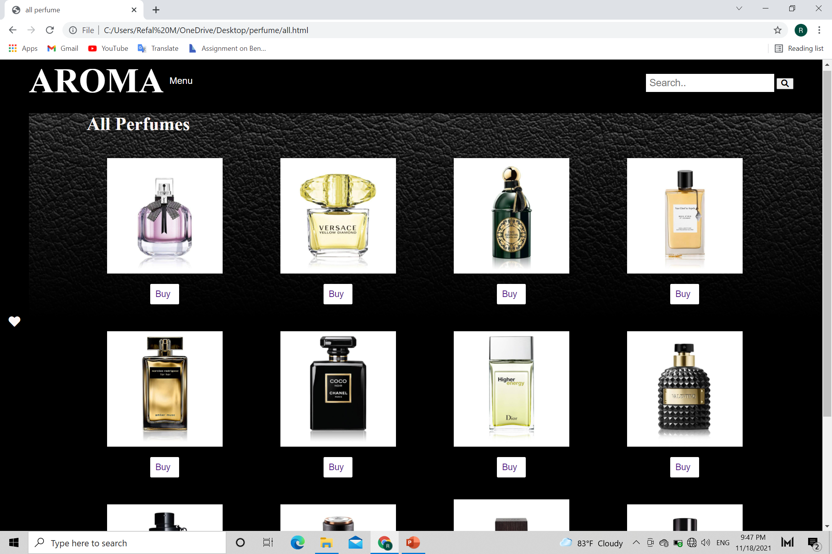
Here, the user can find All Perfumes page.

Slide 8
Thank you for your time
Programmed & designed by:
Rifal AL-Mehmadi
Rana AL-Meataz

